Slide 1
Nordic participation in CAEP/11
N-ALM 15-16th of November in Helsinki
Marie Hankanen

Slide 2
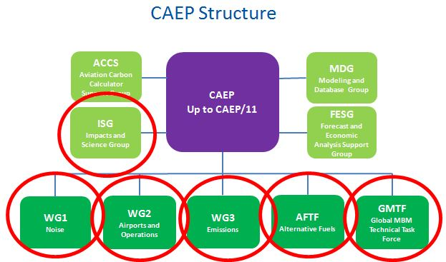
Nordic participation in CAEP/11

Slide 3
Status for work under CAEP/AFTF
List of LCA default values to be used by operators to report their emissions in CORSIA from their alternative fuels use (feedstock production to tank of aircraft).
Computation of Induced land use change emissions from alternative fuels for all world regions (to be used in CORSIA).
Sustainability criteria in CORSIA
Guidelines on potential policies for the deployment of sustainable alternative fuels
Roundtables, potential in climate change goals
Notes:
SC – politically sensitive, could mean yes or no. Environment first, social and economic criteria at a later stage

