Slide 1
ICAO Market Based Measure for Int. Aviation
Karl Koefoed
N-ALM Helsinki 15-16 November 2016

Slide 2
Setting the scene – the global aviation growth
Considerable growth in global aviation
+ 6,5 % in passengers in 2015 compared to 2014
Highest growth rate since the financial crisis
All parts of the world show growth
Strongest growth in emerging markets (India + 20%)
Growth relatively low in Africa, Europe, and North-America
Ticket sales "fuelled" by low oil prices and lower fares

Slide 3
Air Transport Development
+5.5%
growth rate vs. 2012
5.8 trillion RPK
Scheduled commercial traffic
Source: ICAO Annual Reports of the Council (preliminary figures)
Total (international and domestic) services

Slide 4
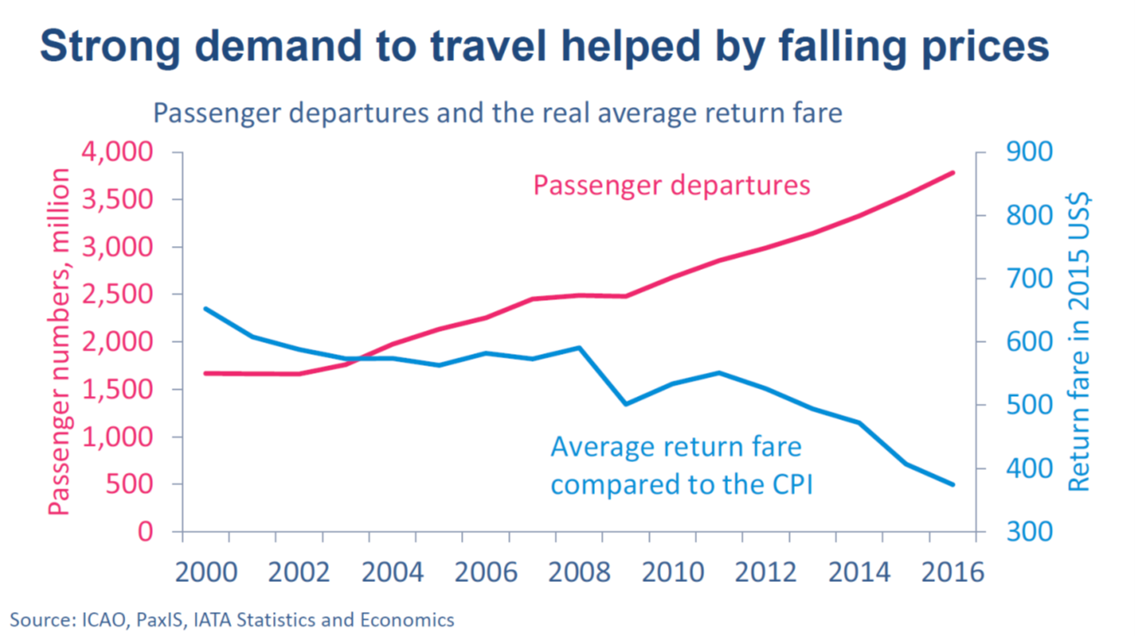
Global aviation market: Increase in demand/traffic and falling fares

Slide 5
Introduction – global aviation and emissions
Aviation accounts for about 2% of global CO2 emissions
About 1,3 % if we only consider international aviation
This figure may double by 2050
Cause: Growth rate and decarbonisation in other sectors
Improvements technological/operational/alternative fuels
Significant research and development projects
Aviation – particularly energy consuming activity
More dependent on fossil fuels than many other sectors

Slide 6
Introduction – ICAO and the MBM
International aviation CO2 emissions – ICAO since 1997
Aircraft – moving assets = cross-border activity (cannot be attributed to a single State)
ICAO taking measures "Basket of measures"
A38 – 2013: A global MBM to be developed towards A39-2016
Global Market Based Measure foreseen as a "gap filler" until other measures take full effect to reach CBNG 2020
2015: Paris Agreement – expression of strong political ambition
2015: Draft Resolution text for a MBM proposed by ICAO

Slide 7
Preparatory work leading up to the ICAO Assembly
ICAO draft resolution text proposal subject to considerable difficult discusssions/negotiations/consultations in 2016
ICAO Council discussions
ICAO "Global Aviation Dialogues" – (GLADs) with stakeholders in the Regions
An ICAO "High Level Group" consisting of selected states
" ICAO High level meeting" and "ICAO friends of the president meeting" open to all states
Bilateral/multilateral discussions outside of the ICAO context
European Coordination – "the ECAC Bratislava declaration"

Slide 8
CORSIA – the ICAO market based measure
Preference for non-MBM measures (gap filler)
Goal is CBNG growth from 2020
Does not include domestic flights (international flights only)
Airlines buy emission units and thereby offsett their emissions
Emission units can be purchased from eligible mechanisms/projects/programmes (Ex: CDM Paris Agreement)
Expected offsetting scenario 158 millions tonnes of Co2 to be offset in 2025 and 703 million tonnes of CO2 i 2040 (estimations by ICAO)

Slide 9
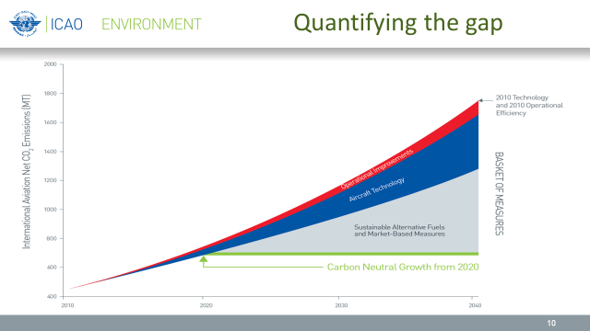
"Gap filler"

Slide 10
CORSIA – some important paragraphs
Par. 2 Preference for non-MBM meaasures
Par. 5 The goal of the MBM – CBNG 2020
Par. 8 Special Circumstances Respective Capabilities (SCRC)
Par. 9: Phased implementation – who is in and when?
Par. 10 Route-based approach – all operators on same routes
Par. 11 Calculation of growth in the system sectorial/individual
Par. 15 Work on MRV, EUC, and Registries
Par. 18 Regular review
Par. 19 National/regional MBMs

Slide 11
A39 - First Assembly debate (Ex. Committee)
First debate 29 sept - European strategy – keep the text as is
Very positive momentum in the first debate coming from all regions of the world supporting the text
A solid majority in the room for the proposed text in the WP
Small minority still wanting amendments (however also consisting of some bigger important States)
Chair concluded the debate would consult with the minority to reach for a consensus acceptable to the solid majority
A lot of negotiations in the backrooms following the first debate

Slide 12
A39 - Second Assembly debate (Ex Committee)
Chair proposed new text version on 5 October
Added a reference in the preamble to negotiations under the UNFCCC and in other international organizations
Added compromise text reached by US and China on developed/developing States in Par. 9C
Brazil wanted a stronger reference to consider emissions units generated under the UNFCCC and the Paris Agreement.
Chair chose to consult again, but at the same time keep overwhelming majority for the new text

Slide 13
A39 – Final adoption (Ex Committee and plenary)
6 October – last day of the Assembly – Modified text proposed
Relations to the UNFCCC and the Paris Agreement
The MBM was adopted as last point remaining on the Assembly agenda – both in the Executive Committee and the plenary
India and Russia made reservations
Russia did not exclude eventual future participation
Sweden supported on behalf of 44 EU/ECAC-states
Egypt supported on behalf of 54 African States
China and many others supported text

Slide 14
MBM – More work to be done for ICAO and States
ICAO Council and CAEP – Development of SARPs /guidance
Further development of MRV / EUC / and Registries
Training and capacity building in the Member States
National implementation of the MBM in the Member States
EU: Discussions on the future of the EU ETS?
EU: "EU ETS Stop the clock" comes to an end
EU: COM to make proposal on ETS early in 2017

Slide 15
ICAO MBM – Conclusions
An important first step and a skilfully drafted compromise
First of its kind sector emissions agreement
Would have preferred to see more ambition
Review clause allows for increased ambition over time
66 States so far signed up for the voluntary phases
ICAO standing up to challenge
Responding to political pressure from the Paris agreement
Difficult implementation remaining

