Slide 1
Pilot project – Environmental assessment
Wennberg/Wiklander
N-ALM May 2017

Slide 2


Lena Wennberg
Director Environment Department
Strategy and Sustainability
Niclas Wiklander
Environmental Specialist
Air Traffic Controller

Slide 3
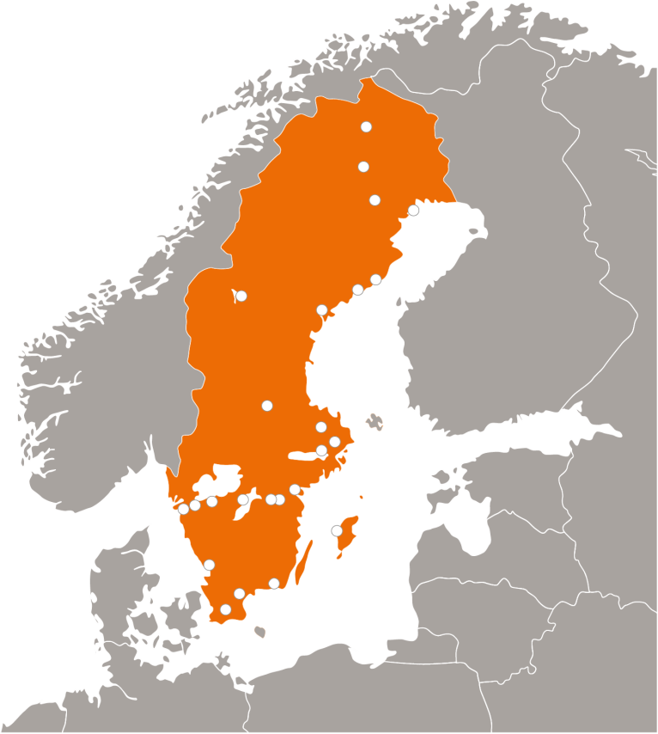
LFV in Sweden
State owned enterprise (1 200 employees)
23 Tower operations (TWR)
2 Air Traffic Control Centres (ATCC)
2 Approach Centres (TMC)
1 Remote Tower Centre (RTC)
Civil and military integrated ANSP since 1978

Slide 4
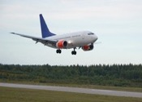
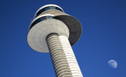
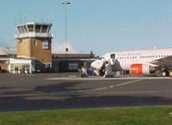
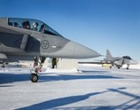
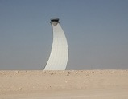
LFV’s 5 delivery areas
En Route
Swedavia
The Swedish market
Swedish Armed Forces
International market

Slide 5
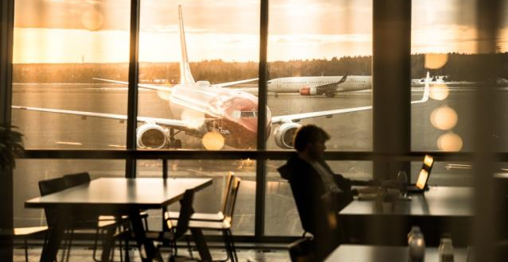
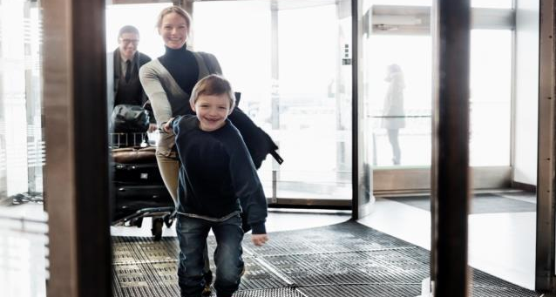
Swedavia
Together we bring the world closer
10 airports
Facilitate travelling, business and meetings
Safe and happy passengers
Developing climate smart airports
Employees: approximately: 2,900
39.5 million travellers
Notes:
Our vision is ”together we bring the world closer”.
Swedavia is a state-owned company that owns, operates and develops Sweden’s national basic infrastructure of airports – a network of ten airports from Malmö in the south to Kiruna in the north, which connects Sweden to the rest of the world.
Our role is to create the access Sweden needs to facilitate travel, business and meetings – both in Sweden, elsewhere in Europe and around the world. We work actively, based on sound business principles, to develop the transport sector and help achieve the transport policy objectives adopted by the Swedish parliament.
Create business growth by increasing travel to and from Sweden
Good airline accessibility is a requirement for new business start-ups
Our focus is to make travellers feel safe, secure and satisfied at our airports.
Swedavia is world leading in climate efforts and actively works for a sustainable future.

Slide 6
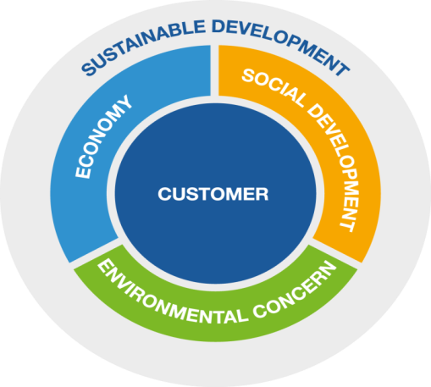
Sustainability– strategy and starting point
7%
return on operating capital
75%
committed employees
2020
Result 2016
8,6%
Result 2016
64%
85%
passenger satisfaction
2020
0
carbon dioxide emissions
2020
Result 2016
77%
Result 2016
2723 tonnes
Notes:
Swedavia creates value through sustainbility. As a state-owned company, Swedavia is expected to act as a role model within sustainable development.
Customer focus and sustainable development are the basis for Swedavia’s entire operation; achieved targets, chosen strategies and implemented decisions. This long term operation has made Swedavia world leading in development of airports with least enviromental impact.
Gearing is also part of Swedavia’s sustainability goals.
Swedavia’s strategic sustainability plan is the basis of the entire operation, with the sustainability wheel and overall goals, as well as strategies and direction.
New targets for 2020
85% satisfied customers (2014 Q3 75% satisfied customers/travellers in total)
75% committed employees
7% return on operating capital
0 ton carbon dioxide emissions

Slide 7
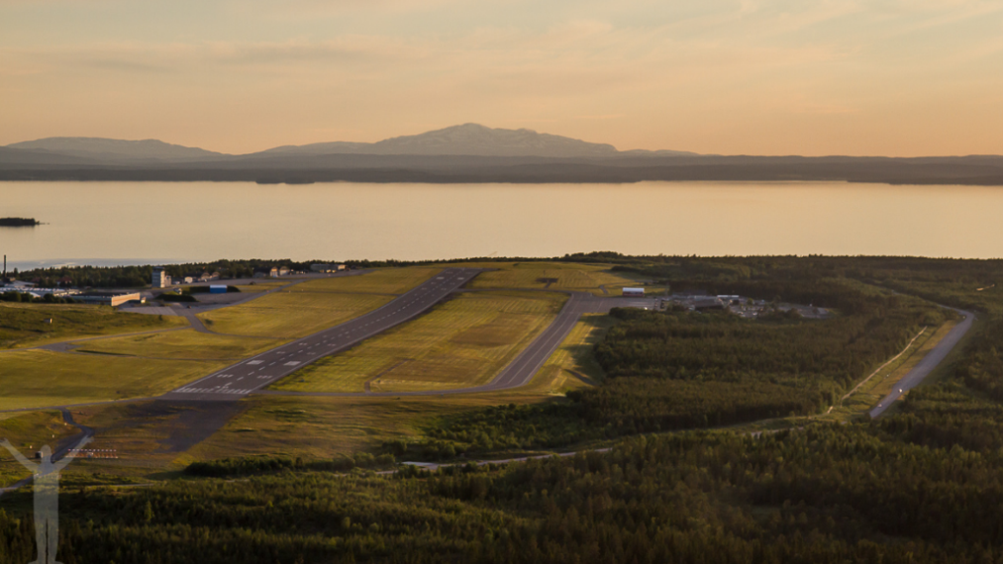
Environmental assesment – OSD
Miljöanalys Åre Östersund
What?
Why?
How?
Åre Östersund Airport - OSD
2nd smallest
11 000 movements
8 000 IFR - flights
© dryden.se

Slide 8
Environmental assesment
Miljöanalys Åre Östersund
What?
  find inefficiences – ”searching for brown fuel”
  measure
  explain/find solutions
OSD
”brown fuel”
xx kg CO2/year
© dryden.se

Slide 9
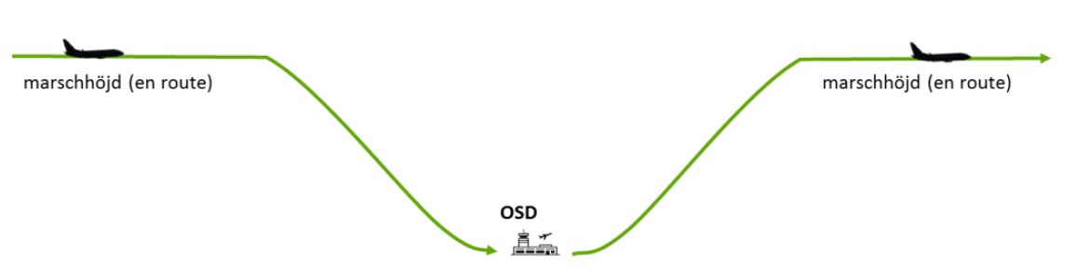
Environmental assesment
All phases of flight
horisontal effiency
vertical effiency

Slide 10
Environmental assesment
Miljöanalys Åre Östersund
What?
Why?
How?
© dryden.se

Slide 11
LFV – sustainable ATM
LFV and focus on the environment
formal requirements
air traffic in a global context
reduced costs for customers
Swedavia and other airport operators
ACA – level 3
”environmentally adapted”
ISO 14001:2015
SES RP2/RP3
environmental goal
SAS: 1% - 75 miljoner
ATM – around 6%

Slide 12
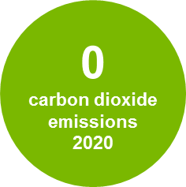


Zero carbon dioxide emissions 2020
Tonnes
Notes:
Own operations!
Swedavia has long worked determinedly to reduce the climate impact of aviation in general. In this important work, it is important first to set goals, develop and monitor our own activities. Only when we ourselves have shown the way we gain the power to affect others. Within our own operations, we have set the ambitious goal of zero emissions of fossil carbon dioxide by 2020, which every indication indicates that we will achieve.
Remaining emissions: 95& Vehicles and fuel

Slide 13




Swedavia Airports - world leading in operating climate smart airports
...continuous decrease of carbon dioxide emissions
...engage other companies, such as airlines, catering companies and public transport companies, in the work on climate change
... is climate neutral considerable emissions from own operations
Notes:
A scheme to implement carbon management processes and to grade the achievements for airports
Designed in a partnership between Airport Council International Europe (ACI Europe) and WSP Environmental.
The scheme is overwieved by representants from EU, UNEP (United Nations Environmental Programme), Eurocontrol
Four levels;
Mapping (1),
Reduction (2),
Optimisation (3),
Neutrality (3+)
Engagera andra: Genomn krav i framkallsningssystem på ARN BMA och GOT har vi bidragit till omställning av taxiflottan till miljöbilar, i Stockholm och Göteborg. Samarbeten med bussbolagen etc.
CDM/Gold Standard-projekt.
Out of the 29 ACA-neutrality-certified airports in Europe, ten of them are our Swedavia airports. Arlanda was first to be certified at the highest level Neutrality 2009.
[Last controlled 2017-04-13]

Slide 14
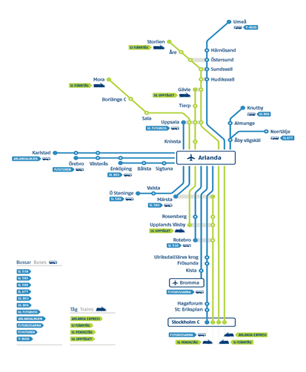
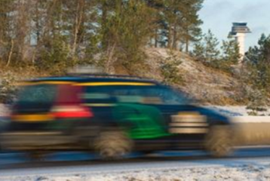
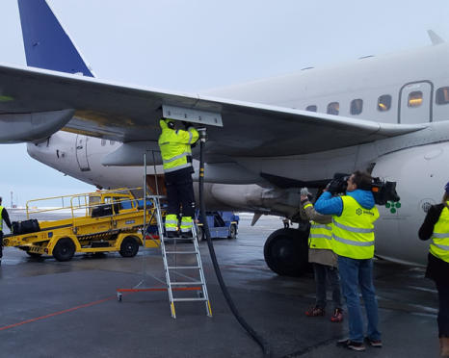
Engage other companies,
Reducing emissions from ground transportation
Bio Jetfuel
Efficient airspace

Slide 15

Environmental assesment
Miljöanalys Åre Östersund
What?
Why?
How?
© dryden.se

Slide 16
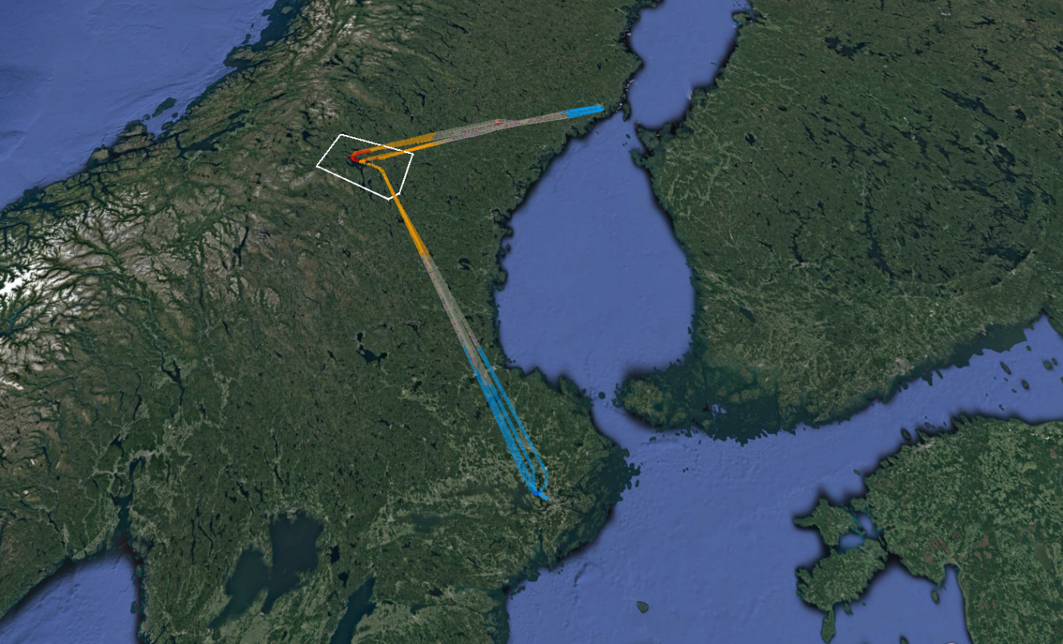
How to find inefficiences?

Slide 17
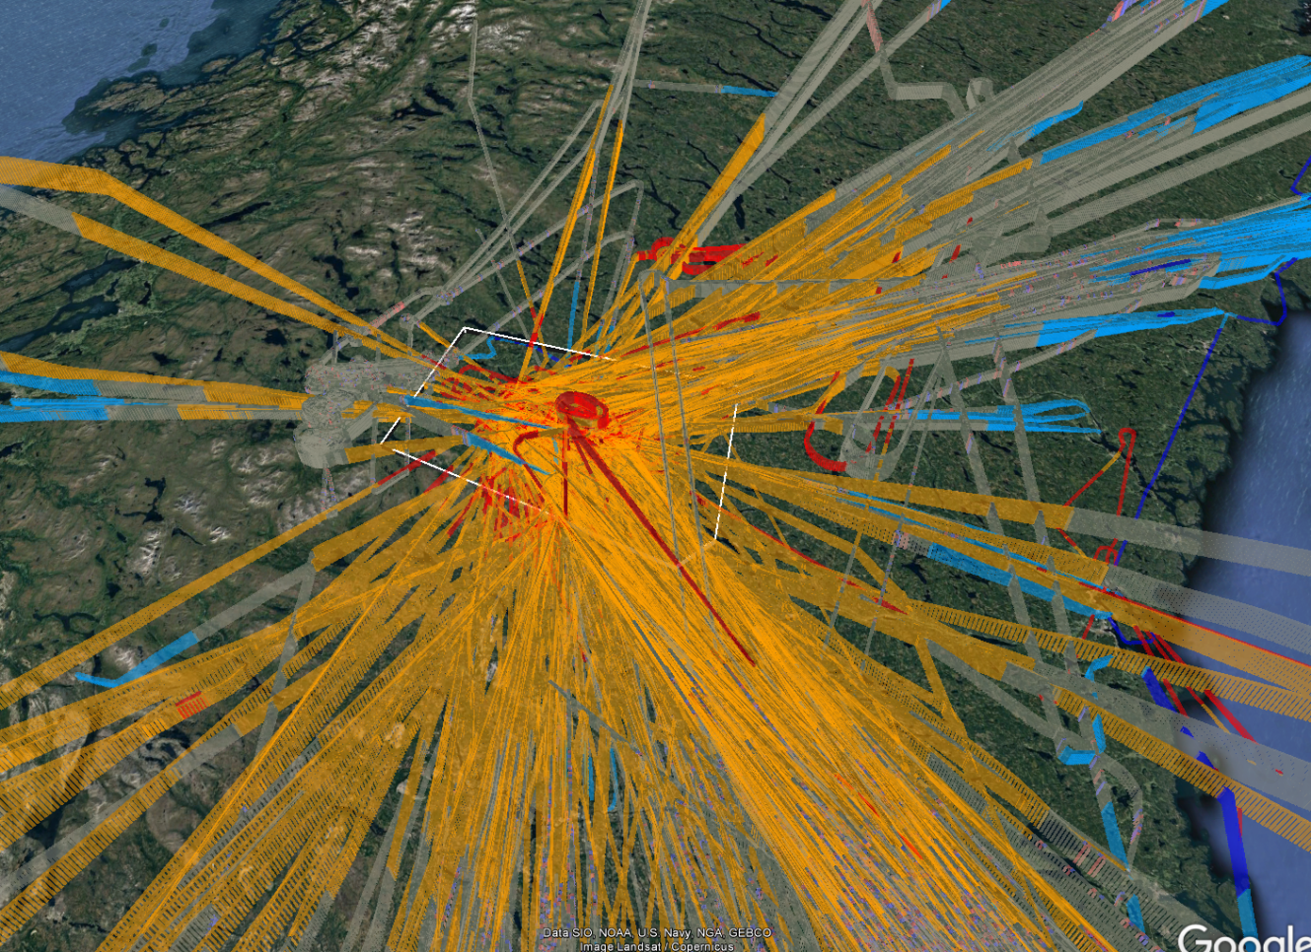

Slide 18
Three different perspectives
effects on emissions
ATM system
environmental permit
aircraft/pilot performance

Slide 19
Environmental aspects
optimum cruise speed
optimum cruise speed
optimum cruise level
optimum cruise level
plan short
plan short
fly short
optimum Top-of-Descent
direct routing
fly short
short STAR/apch
short SID
level segment
level segment
descent speed
climb speed
time with engines on

Slide 20
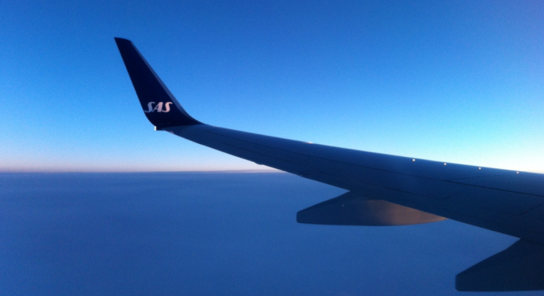
Data sources
LFV GAIA – environmental analysis tool
Environmental permit
AIP
LFV Operating Manuals
  ATC
  Airspace design
ATC
  ATS Östersund
  ATCC Stockholm
Eurocontrol
Swedavia ATM unit
Airliners
  SAS
  BRA
  Novair

Slide 21
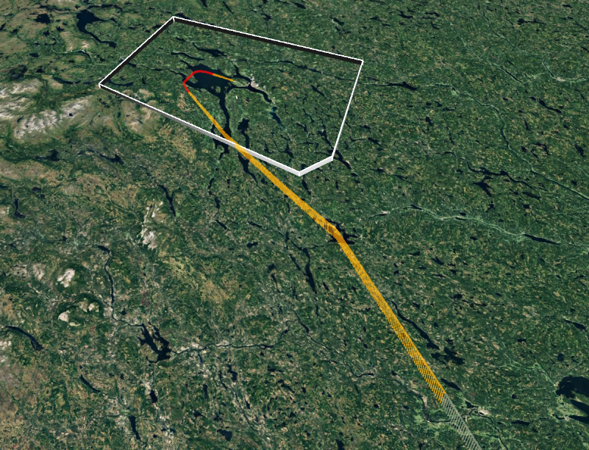
GAIA
level segment – 200 seconds
11 000 feet – 5,4%
20,2 NM extra miles
Top of descent

Slide 22
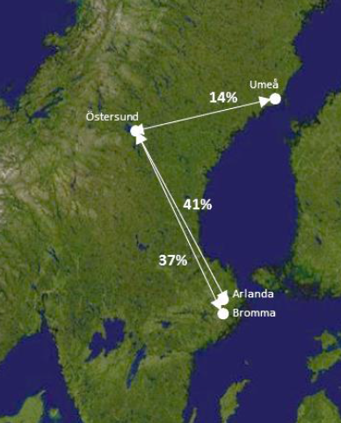






Flight Operations
Three main traffic flows
Four operators
Six dominant aircraft types
Six flight operations (88%)
=
+
+
flight operation
flight operation
+
+
=

Slide 23
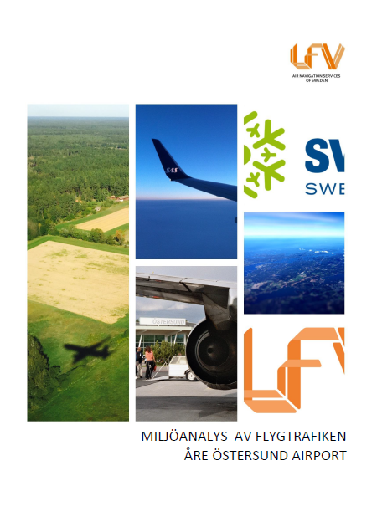
Results
Five areas of improvement
Airspace design – Terminal Area
Time in level flight – approach
Approach procedure
Runway in use – noise vs emissions
Leave departure routes earlier
75 tonnes CO2 annualy

Slide 24
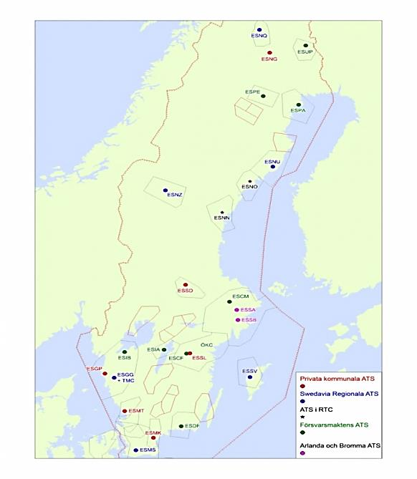

Next step

Slide 25
Conclusion
Reduced fuel burn
Quality assurance
Better communication between all stakeholders
A generic model for other airports
Baseline for future re-design of Swedish airspace

Slide 26
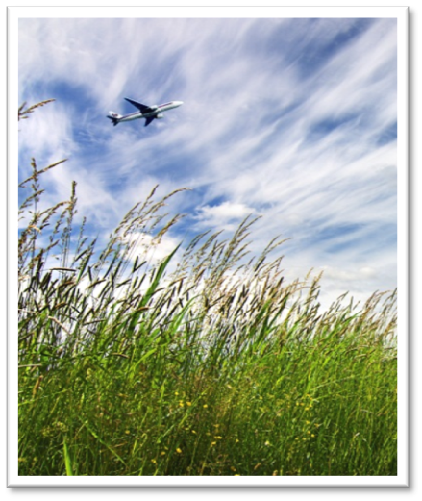

Contributes to the potential for large scale production
Through collaborations Swedavia initiates studies for production of sustainable biofuel in Sweden
Three requests submitted
Watch our film:
Swedavia flies on biofuel

